Slide 1
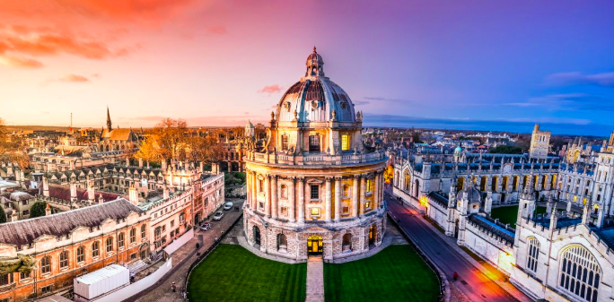
The UK metformin in Li Fraumeni (MILI) Study
Sarah Blagden
Funding Approved by NIHR
Endorsed by NCRI SPED and ECMC UKTCPN committees
UK LFS meeting 11/09/21

Slide 2




Funding approved
NIH - MILI
approx. 250 adults
Funding approved
MILI
approx. 220 adults
>600 patient IPD META-ANALYSIS
MILI-PAED
approx. 200 children
CI: Morgenstern
SHARED PROTOCOL
German - MILI
adults and children
CI: Christian Kratz

Slide 3
Funding approved
NIH - MILI
approx. 250 adults
Funding approved
MILI
approx. 220 adults
>600 patient IPD META-ANALYSIS
MILI-PAED
approx. 200 children
CI: Morgenstern
SHARED PROTOCOL
German - MILI
adults and children
CI: Christian Kratz

Slide 4
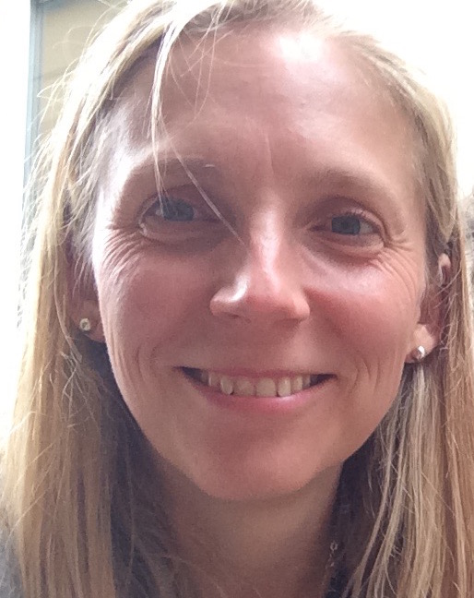

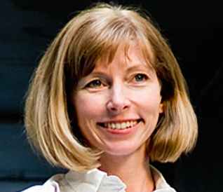
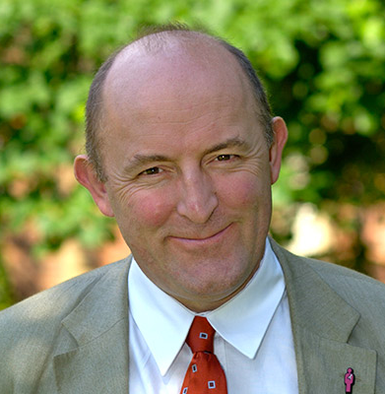

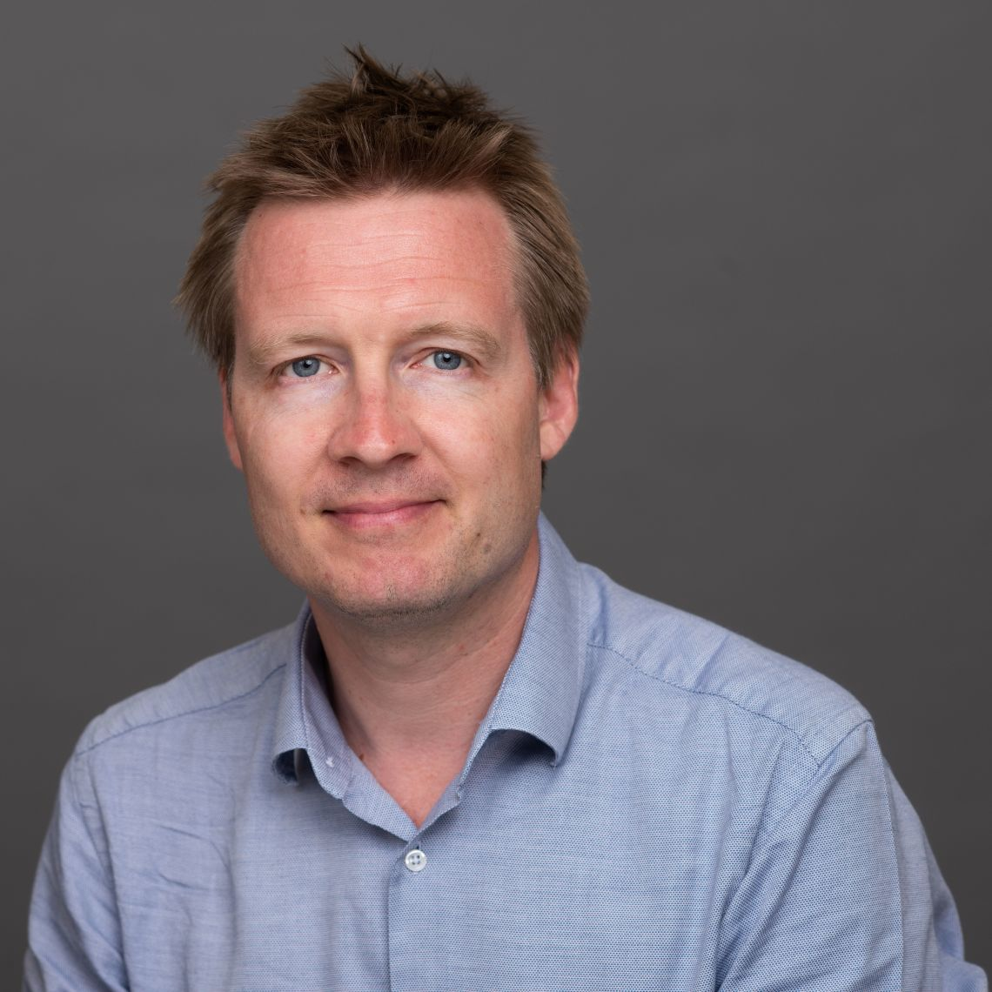
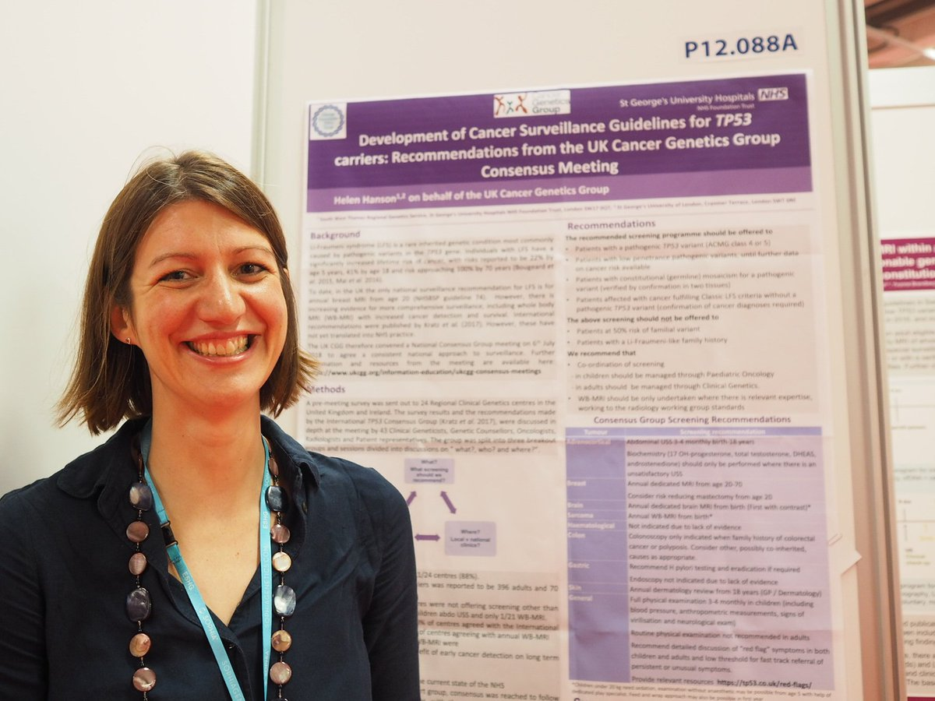

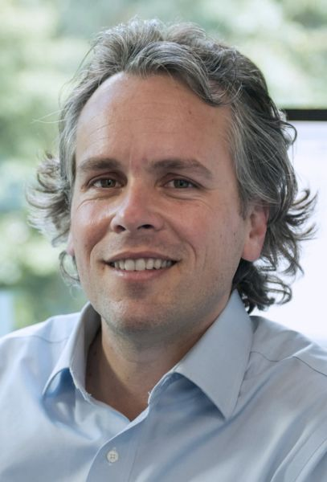
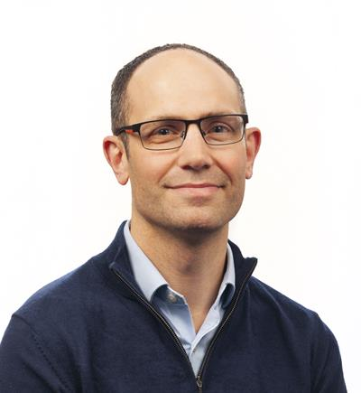
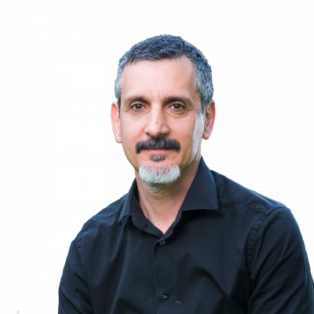
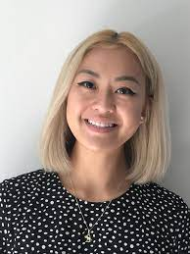
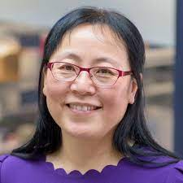
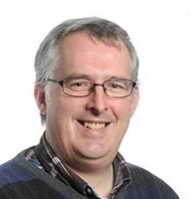
The UK’s MILI team
Principal Investigator Oxford
Sponsor:
Dr Lara Hawkes Consultant Cancer Geneticist, University of Oxford. BRCA risk stratification
Chief Investigator
Dr Sarah Blagden Associate Professor of Medical Oncology, University of Oxford.
Principal Investigator Manchester
Prof Gareth Evans Consultant Cancer Geneticist, University of Manchester.
Translational Leads
Dr Simon Lord, Consultant Medical Oncologist,
University of Oxford.
Principal Investigator London
Dr Helen Hanson Consultant Cancer Geneticist, St Georges Hospital, London
Funder:
Prof Gareth Bond, Genetics and Genomics University of Birmingham
Radiology Lead
PPI representatives
Dr Jamie Franklin
Consultant Radiologist
Bournemouth University
Prof Xin Lu
Ludwig Institute
University of Oxford
Statistician
Prof John Norrie
Statistics, University of Edinburgh
Elizabeth Sam & Verity Easton
.
Dr Pan Pantziarka
George Pantziarka tp53 Trust.

Slide 5
What questions are we asking?
Does metformin prevent or delay the emergence of cancer in people with LFS
Why does cancer happen in LFS?
Are some P53 mutations more cancer-forming than others?
What is the impact of yearly prevention and/or surveillance on quality of life?

Slide 6
Study Design and Recruitment
224 people aged ≥16y with LFS in UK, recruitment commences January 2023
Randomised 1:1 to cancer surveillance + metformin versus cancer surveillance alone
Those randomised to metformin will receive drug by post, have telephone side effect assessment and will send capillary bloods by post
Surveillance will comprise bloods, annual whole body MRI and brain MRI and dermatological examination
Three centres: Oxford, London (St George’s) and Manchester will act as hubs for consenting and scanning
Recruit over 2 years and on metformin for 5 years
Longer term (10 and 15 year) survival follow-up planned
Data pooled into a single international meta-analysis.

Slide 7
How to join MILI – starting Jan 2023
The 24 UK Regional Genetics centres will be registered as MILI Participant Identification Centres (PICs)
Dr Helen Hanson, Chair of the UK Cancer Genetics Group, will distribute a letter that will be sent to LFS patients from PICs.
The letter/GPTT website will include a link to the MILI website
Those attending genetics centres will be checked for eligibility and referred to their preferred/nearest MILI Trial Centre (Oxford, Manchester or St George’s).
Here they will be assessed and consented.
Following screening evaluation, patient details will be sent to Oxford Cancer Trials Office (OCTO) for randomisation.
Patient travel costs will be refunded and will be required to travel to centres for scans but otherwise will post samples and telephone follow-up.

Slide 8
Aims
PRIMARY: Cumulative cancer-free survival up to 5 years
SECONDARY: Tumour-free survival up to 5 years
Overall survival
Incidence and spectrum of emerging malignancies
Safety and toxicity of metformin
Acceptability of metformin
Impact on quality of life
Baseline lifestyle risk factors

Slide 9
RESEARCH endpoints (separate funding application):
Research Objectives | Research Endpoints
Distribution of P53 mutations and outcome | Location and type (missense etc) of TP53 mutation by next generation sequencing in PBMCs and correlated with time until emergence, type and location of cancer
Correlation between histological features of emergent tumour tissue between patients in the two study arms | Histological/ immunohistochemical, genomic and epigenetic features of tumour tissue collected at the time of surgery and compared to peripheral samples
Levels of p53 protein expression | Measurement of p53 protein expression using mass spectrometry in PBMCs alongside P53 sequencing.
Comparison of metabolic marker expression (insulin, glucose, C-peptide, IGF1 etc) alongside change in mitochondrial function | Whole blood transcriptomic analysis in circulating PBMCs to assess mitochondrial pathways including oxidative phosphorylation, glucose, glutamine and aspartate metabolism and fatty acid oxidation. Changes in expression of a validated proliferation metagene signature.
Correlation of circulating immune cells, epigenetic, proteomic and autoantibody markers in serial samples - to identify biomarkers | Assessment of serum samples for autoantibodies to p53, immune cells and inflammatory markers and correcting with clinical outcomes. Epigenomic sequencing using cell free DNA. Plasma to identify markers identified above

Slide 10
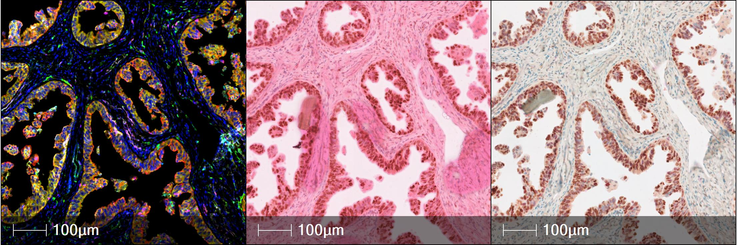
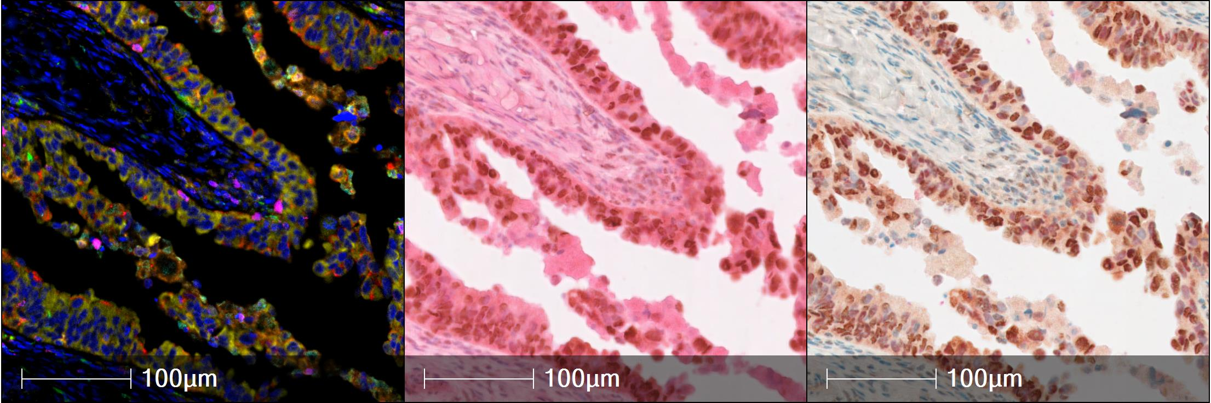
Multiplex IHC
immune cell 7-plex
H&E
P53

Slide 11
Who is eligible?
Inclusion Criteria
Diagnosis of LFS from confirmed pathogenic TP53 variant (class IV or V by ACMG criteria)
Aged ≥16 years
Exclusion Criteria
Currently taking metformin or previously on it for more than 3 months within 2 years of enrollment
Completion of cancer systemic therapy < 6 months from enrolment
Current type 1 or 2 diabetes mellitus
Presence of ongoing cancer (detected previously or at baseline scanning) or concurrent life-threatening illness
Current pregnancy or lactation
Gastro-intestinal condition (such as short-bowel syndrome) that could affect uptake of metformin
History of heart conditions
Evidence of significant renal impairment eGFR < 45ml/minute/1.73m²
Liver cirrhosis and/or alkaline phosphatase, aspartate transaminase or alanine transaminase >2.5 x upper limit of normal (ULN)
Elevated risk of lactic acidosis such as current chronic alcoholism, congenital lactic acidosis, concurrent intake of carbonic anhydrase inhibitor (e.g. acetazolamide)
Known allergy to metformin

Slide 12
MILI UK will…
Contribute data to the international meta-analysis – largest of its kind in LFS
Confirm whether metformin is an effective cancer preventative in LFS
Enforce co-ordinated yearly whole body MRI scanning surveillance
Provide evidence for regulatory approval to prescribe metformin in LFS
Help us determine why/how LFS leads to cancer
Generate a large database to improve the assessment and reporting of whole body MRI
Establish the UK’s first National LFS Registry and biobank
Be one of the UK’s first Precision Prevention Trials
Open the door to more LFS cancer prevention trials via the international group

Slide 13
STUDY SCHEMA
YEAR 1
YEAR 2
YEAR 3
YEAR 4
YEAR 5
S
S
S
S
S
S
P
Month 1
Month 2
P
P
P
P
P
D
D
D
D
D
D
C
M
M
M
M
M
M
Screening/randomisation
Week 1
Week 3
Week 5
Week 7
Months 3-6
Months 6-12
Months 0-12
Months 0-12
Months 0-12
Months 0-12
EOS
Q
T
T
T
T
Q
Q
Q
Q
Q
METFORMIN / NO INTERVENTION (1:1)
PROCEDURES
Quality of Life Questionnaires
D
Examination and Dermatological Assessment
Q
C
Given PIS and consented
M
Whole Body & Brain MRI scan
S
Safety review with haematology & biochemistry blood tests (at baseline) and FBC only thereafter
P
Pharmacodynamic Blood sampling
T
Telemed Safety and symptom review, U&E sent by post

Slide 14



Thank you to the LFS community and to..
The National and International MILI team
David Malkin and Daniel Morgenstern (Canada)
Payal Khincha (NCI, USA)
Christian Kratz (Germany)

