Slide 1
The metformin in Li Fraumeni (MILI) Study

Slide 2
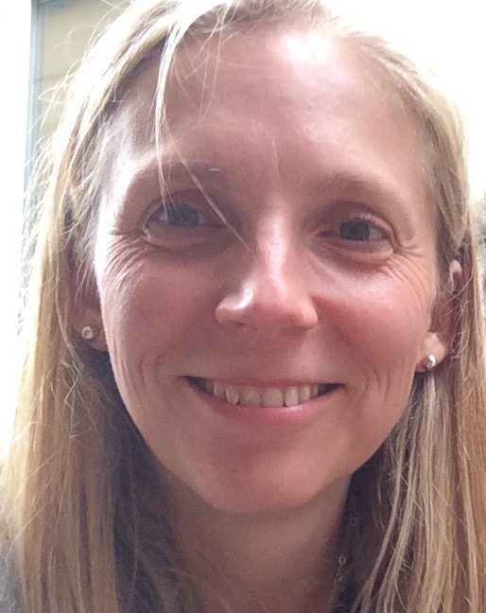
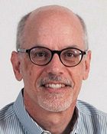
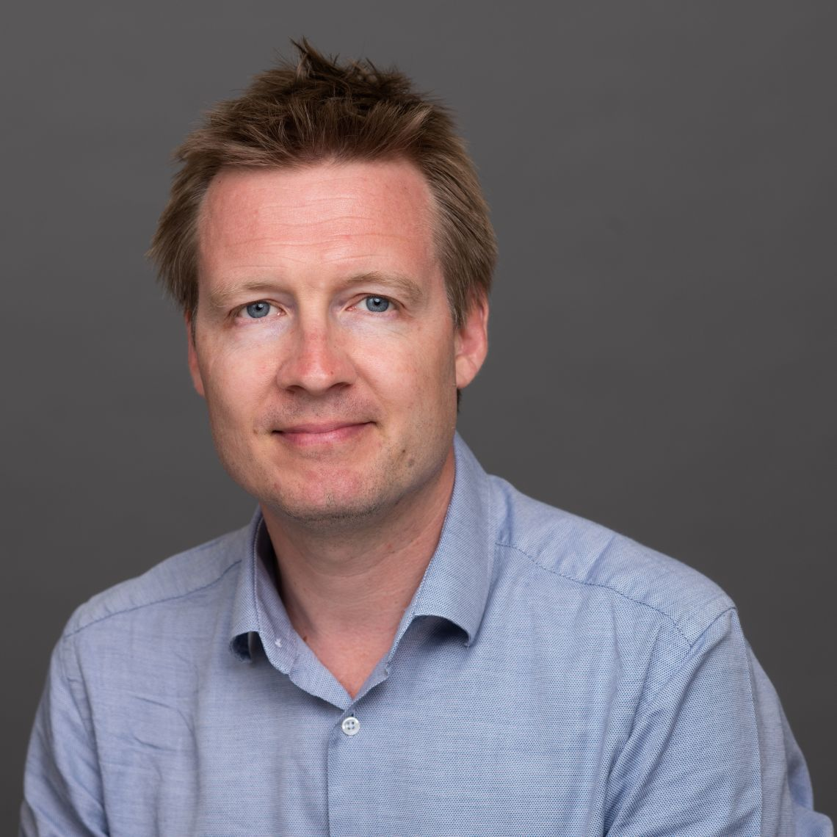
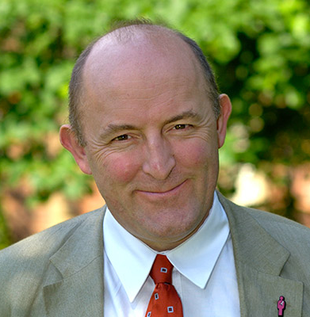
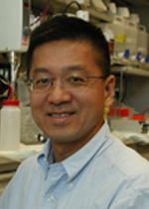
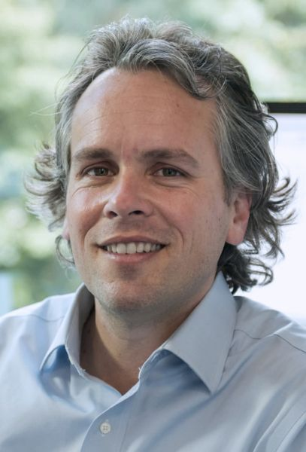
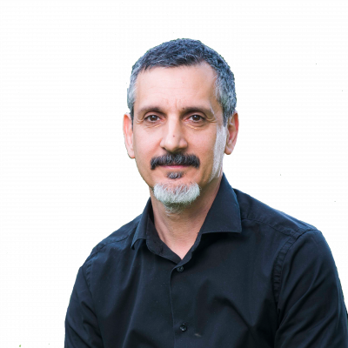
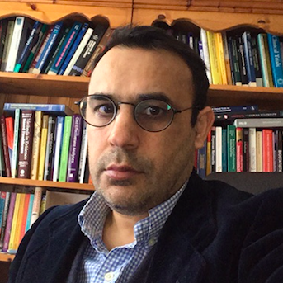
The MILI team
International Collaborators
Dr Sarah Blagden Associate Professor of Medical Oncology, U of Oxford. Early Phase Trials /translational research
Prof David Malkin Paediatric Oncologist, Hospital for Sick Kids, Toronto. LFS expert, lead for MILI-paed study
Dr Lara Hawkes Consultant Cancer Geneticist, University of Oxford. BRCA risk stratification
Dr Simon Lord, Consultant Medical Oncologist, U of Oxford. Early phase trials/ translational research/ metformin
Prof Gareth Evans Consultant Cancer Geneticist, University of Manchester.
Prof Paul Hwang Senior Investigator, NIH, USA. LFS and metabolism expert
Prof Gareth Bond, Genetics and Genomics – science lead, University of Birmingham
Dr Helen Hanson Consultant Cancer Geneticist, St Georges Hospital, London
Dr Payal Khincha Clinical Geneticist, NCI, USA
Designed the US study
Dr Pan Pantziarka, George Pantziarka tp53 Trust.
Drug repurposing, access to LFS support groups
PPI representative:
Statistics:
Dr Iftekhar Khan
Medical Genetics, University of Oxford/MHRA, statistical design & analysis
Elizabeth Sam
George Pantziarka tp53 Trust

Slide 3
Background
Li-Fraumeni syndrome (LFS) is a rare inherited cancer predisposition syndrome
It affects between 1/5000 to 1/20000 people, in UK approximately 5,500 although only 500 have been diagnosed with it
LFS is caused by germline pathogenic variants in TP53, a tumor suppressor gene.
Lifetime risk of cancer =90% by age 60 years.
Half of women with LFS will develop a cancer by age 31 years and half of men by age 46 years.
Typical “core” cancer types include: bone and soft-tissue sarcomas, pre-menopausal breast cancer, brain tumors and adrenocortical carcinomas.
While cancer surveillance has been shown to be successful in early detection of cancers in LFS, cancer prevention in individuals with LFS has thus far been unexplored.

Slide 4
What makes a clinical diagnosis of LFS?
Chompret Criteria Syndrome:
A diagnosis of LFS and performing TP53 gene mutation testing is considered for anyone with a personal and family history that meets 1 of the following 3 criteria:
Criterion 1
• An LFS tumour before the age of 46: soft-tissue sarcoma, osteosarcoma, pre-menopausal breast cancer, brain tumour, adreno-cortical carcinoma, leukaemia, or lung cancer, and
• At least 1 first-degree or second-degree family member with an LFS-related tumour (except breast cancer if the individual has breast cancer before the age of 56) or with multiple tumours
Criterion 2
• A person with multiple tumours, except multiple breast tumours, 2 of which belonging to the LFS tumour spectrum and the first of which occurred before age 46
Criterion 3
• A person who is diagnosed with adrenocortical carcinoma or a tumour in the choroid plexus regardless of family history.
Classic LFS
All the following: • A sarcoma diagnosed before age 45
• A first-degree relative with any cancer before age 45
• A first-degree relative or second-degree relative with any cancer before age 45 or a sarcoma at any age
Li-Fraumeni-Like Syndrome (LFL) is another, similar set of criteria for affected families who do not meet Classic criteria. There are 2 suggested definitions for LFL:
LFL Definition 1, called the Birch definition:
A person diagnosed with any childhood cancer, sarcoma, brain tumour, or adrenocortical tumour before age 45 and A first-degree or second-degree relative diagnosed with a typical LFS cancer, such as sarcoma, breast cancer, brain cancer, adrenocortical tumour, or leukaemia, at any age and a first-degree or second-degree relative diagnosed with any cancer before age 60
LFL Definition 2, called the Eeles’ definition:
2 first-degree or second-degree relatives diagnosed with a typical LFS cancer, such as sarcoma, breast cancer, brain cancer, adrenal cortical tumour, or leukaemia, at any age

Slide 5
Tp53
(chrom 17p)
Majority of pathogenic mutations are missense mutations in exons 5-8 – DNA binding region
P53 responds to genomic instability by:
Inhibiting metabolism
Inducing cell cycle arrest
Inhibiting angiogenesis
Inducing cell death
Inducing senescence

Slide 6
Tp53
(chrom 17p)
mutated
P53 responds to genomic instability by:
Activating metabolism
Preventing cell cycle arrest
Activating angiogenesis
Preventing cell death
Preventing senescence
tumorigenesis

Slide 7
Current screening pathway for a LFS patient – USA (with insurance)
Twice yearly breast examination, 6 monthly MRI
Surgery: Bilateral mastectomy and reconstruction. Then HRT until natural menopause age (50)
MRI-b
MRI-b
MRI-b
MRI-b
MRI-b
MRI-b
MRI-b
MRI-b
MRI-b
WB- MRI
WB- MRI
WB- MRI
WB- MRI
WB- MRI
WB- MRI
WB- MRI
WB- MRI
OGD and colonoscopy every 2-5 years
20 y
40 y
25 y
Annual dermatological assessment
Annual breast MRI alternating with whole body MRI (6 monthly)
Risk reducing mastectomy, no mammography
Life-time avoidance of radiation (Xray)
No chemoprevention has been assessed
National Database and Biobank established

Slide 8
Current screening pathway for a LFS patient - UK
Yearly breast MRI 20-50y
Yearly mammogram from 50
MRI-b
MRI-b
MRI-b
MRI-b
MRI-b
MRI-b
MRI-b
MRI-b
MRI-b
Surgery: Bilateral mastectomy and reconstruction.
20 y
50 y
25 y
Yearly breast MRI for females who have not had bilateral mastectomy
No whole body MRI –study recently published (Saya et al, 2017) showed benefit but not approved as SOC in UK
No chemoprevention has been assessed
No national database and no biobank

Slide 9
Tp53
(chrom 17p)
mutated
P53 responds to genomic instability by:
Activating metabolism
Preventing cell cycle arrest
Activating angiogenesis
Preventing cell death
Preventing senescence
tumorigenesis

Slide 10
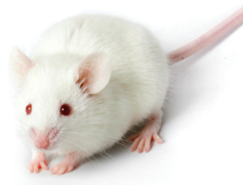
Mutant P53 activates metabolism by increasing mitochondrial function and oxidative phosphorylation
Seen in mice and LFS patients (NEJM 368(11):1027-32, 2013).
Mouse model of LFS with mtDNA mutations (Polg^{mut}/p53^{172H/H}) – LFS mice lived 2x longer if had mitochondrial mutations. This was reproduced by metformin
STOP
STOP
STOP

Slide 11
Mutant P53 activates metabolism by increasing mitochondrial function and oxidative phosphorylation
Metformin inhibits oxidative phosphorylation in mitochondria
STOP
STOP
STOP

Slide 12
2017

Slide 13
Aims of the Study
To evaluate metformin as a cancer chemopreventative in adults with Li Fraumeni Syndrome
To develop a trials network and master protocol by which other chemopreventatives can be tested (mTOR inhibitors etc)
To establish a LFS database and/or biobank for UK LFS families
To develop an understanding about the molecular events preceding the emergence of cancer in adults with pathological tp53 mutations
To understand the impact of using metformin as a chemopreventative on QOL of participants and health economy

Slide 14
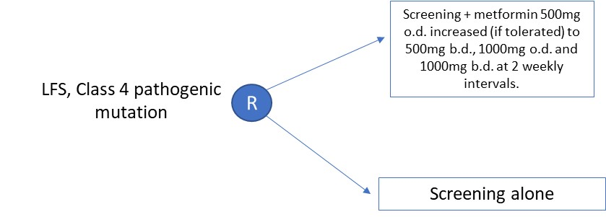
Study Design and Recruitment
Plan to recruit 150-200 adults with LFS in UK
Patients will be randomised 1:1 to screening + metformin versus screening alone
Screening will comprise FBC, annual whole body MRI and brain MRI, dermatological examination and alternate yearly colonoscopy
Patients will be recruited at three centres: Oxford, London (RMH/St Georges) and Manchester via their local genetics teams
The study will recruit over 2 years and follow patients for up to 5 years
Emergent cancers will be managed by referring teams
Survival data will be pooled with equivalent study in NCI (also in planning although funding has been agreed). Other nations will seek individual sponsors and funding but may replicate the study design (Sydney, Australia; Lyon, France and Germany) – these discussions are ongoing.
A paediatric study – MILI-paed will run in parallel in SickKids, Toronto, Canada
Adult with LFS

Slide 15
 | Objectives | Endpoints
Primary | Cancer incidence within 2 years in investigation (metformin + screening) versus control (screening alone) arm of study | Number of scan-detected or clinically-detected cancers identified during study participation within 24 months of randomisation (this does not include cancers detected at baseline)
Secondary | Cancer incidence within 5 years in investigation (metformin + screening) versus control (screening alone) arm of study | Number of scan-detected or clinically-detected cancers identified during study participation within 60 months of randomisation (this does not include cancers detected at baseline)
 | Cancer-free survival in metformin versus control | Time from randomisation to cancer diagnosis or death from any cause
 | iii) Overall survival in metformin versus control | Time from randomisation to death from any cause
 | Safety and toxicity of metformin versus control | Treatment-emergent adverse events (per CTCAE v4), clinically significant laboratory changes (per CTCAE v4) or changes in physical exam and/or vital signs
 | Quality of life of metformin + screening) versus control (screening alone) arm of study | 36-Item Short Form Survey (SF-36)
 | Health economic assessment | EQ5D, QALY (to be confirmed)
Research | Correlation between expression of p53 variants and outcome | TBC
 | Pharmacodynamic: Quantitation of mitochondrial function in circulating PBMCs | Transcriptomic analysis to assess mitochondrial pathways including oxidative phosphorylation, glucose, glutamine and aspartate metabolism and fatty acid oxidation. Changes in expression of a validated proliferation metagene signature.
 | Correlation of lifestyle risk factors with cancer incidence | Measurement of height, weight, BSA
 | Correlation of circulating research biomarkers with outcome | TBC

Slide 16
LFS Adaptive Study Design
Biology phase
N=?? 50
NCI – cell signaling/proliferation markers, mitochondrial function, metabolomics, microbiome
UK - Transcriptomic analysis of mitochondrial pathways including oxidative phosphorylation, glucose, glutamine and aspartate metabolism and fatty acid oxidation. Changes in expression of a validated proliferation metagene signature.
Clinical phase
N= 318 per arm for 10% effect
NCI – adult randomized metformin study
Outcome
FDA approval
Similar outcome in Canada/UK
Canada -
?Australia -
Australia – metformin or screening only??
UK – MILI adult randomized metformin study (expect to recruit 200)
Canada – MILI Paed pediatric randomized metformin study
International Collaborative Clinical Trial with
concurrent correlative biology studies
Timeline: 5 years
Future substudies/additional arm of drug X with relevant concurrent collaborative translational studies

Slide 17
Inclusion Criteria
Known, genetically-confirmed Li Fraumeni Syndrome with p53 mutation
Aged above 18 years.
Able to swallow and retain oral medication.
Adequate organ function as defined below. Including eGFR >50 mL/min
Absence of serological or radiological evidence of malignancy or recurrence of prior malignancy
Exclusion Criteria
Diagnosis of Li Fraumeni-like syndrome or positive risk by Chompret Criteria in the absence of p53 mutation
Current pregnancy or breast-feeding
Currently taking metformin, phenformin or other hypoglycaemic agents (e.g. gliclazide or insulin) for diabetes or other indications
Evidence or history of diabetes mellitus
Evidence or history of cardiac failure and/or myocardial infarction
Previous randomisation into the present study
Serious medical condition other than Li Fraumeni Syndrome that is likely to result in a life expectancy of less than 5 years
Any serious or unstable pre-existing medical, psychiatric, or other condition (including lab abnormalities) that could interfere with subject safety or with obtaining informed consent.
Any condition predisposing patient to lactic acidosis including heavy alcohol usage

Slide 18
Procedure | -14 to 0 (Screening) | C1 D1¹ | C1 D15¹ | C2 D1¹ | C2 D15¹ | 3 Monthly review from C3 onwards for 6 months | 6 monthly review for up to 5 years | EOS
Informed Consent | x
Eligibility checklist | x
Medical History | x
Physical Examination | x |  |  |  |  | X | x | x
ECOG Performance Status | x | x | x | x | x | x | x | x
Haematology & Biochemistry² | x | x | x | x | x | x | x | x
Whole Body MRI³ | x |  |  |  |  |  | x
Brain MRI³ | x |  |  |  |  |  | x
Colonoscopy³ | x |  |  |  |  |  | x
Dermatological examination | x |  |  |  |  |  | x | X
Adverse Events⁴ | x | x |  |  | x | x | x | x
Concomitant Medication | x | x |  |  | x | x | x | x
Blood sample –PD | X |  |  |  | X | x | x
Administration of metformin |  | X (500 mg od) | X (500mg bd) | X (1000mg od) | X (1000mg bd) | x | X
QOL questionnaire | X |  |  |  |  |  | X | X
Both arms will get screening comprising annual whole body (WB) and brain MRI, and dermatological assessment. Colonoscopy will be performed alternate yearly
Women having annual breast MRI will receive this locally as SOC

Slide 19
Progress and Plans
July 2019: Presented UK Therapeutic Cancer Prevention Network Group (UKTCPN) who gave it their blessing
David Malkin seeking funding for paediatric Canadian version of this study
The USA (adult) study has funding from NCI and shares the same endpoints.
PPI group via George Pantziarka TP53 Trust has reviewed the protocol outline and is supportive
October 2019: Presented to Oxford’s Oncology Clinical Trials Office (OCTO) who have agreed to sponsor MILI
25th November 2019: MILI investigator meeting to discuss study design
11th December 2019: To be presented to NCRI’s SPED workshop
April 2020: To be submitted to NIHR’s Efficacy and Mechanism (EME) Funding Round.
Application for Patient Registry in Birmingham (led by Gareth Bond) to be submitted separately

